Slide 1
Covid19 Impact on US Stocks
Teja Potu
Puneeth Reddy Motukuru Damodar
Venkata Sivasai Phani Praveen Mamillapalli
MD. Masum Al Masba

Slide 2
AGENDA
​Ask an interesting question
Data Collection
Explore the Data
​Data Preprocessing
​​Data Modelling
Visualization of interesting outcomes
Summary

Slide 3
Ask an interesting question
COVID-19 pandemic has caused significant impact on the global economy, including the US stock market
Unprecedented levels of volatility and uncertainty observed in the stock market during the pandemic
Data-driven analyses utilized to understand the impact of COVID-19 on US stocks
Techniques such as exploratory data analysis, visualization, and machine learning algorithms employed for data analysis

Slide 4
PRIMARY GOALS
Impact of Covid-19 on US Stock market

Slide 5
Data Collection
Covid dataset from Johns Hopkins Data Repository on Github and transformed the data to our required format.
Web scarping is performed to get the sp500 data from yahoo finance.
Gathered stock prices of various stocks in different industries like Information technology, Clothing, Health Care, Automobile, Consumer goods, etc. from yahoo finance.
Github - https://github.com/CSSEGISandData/COVID-19

Slide 6
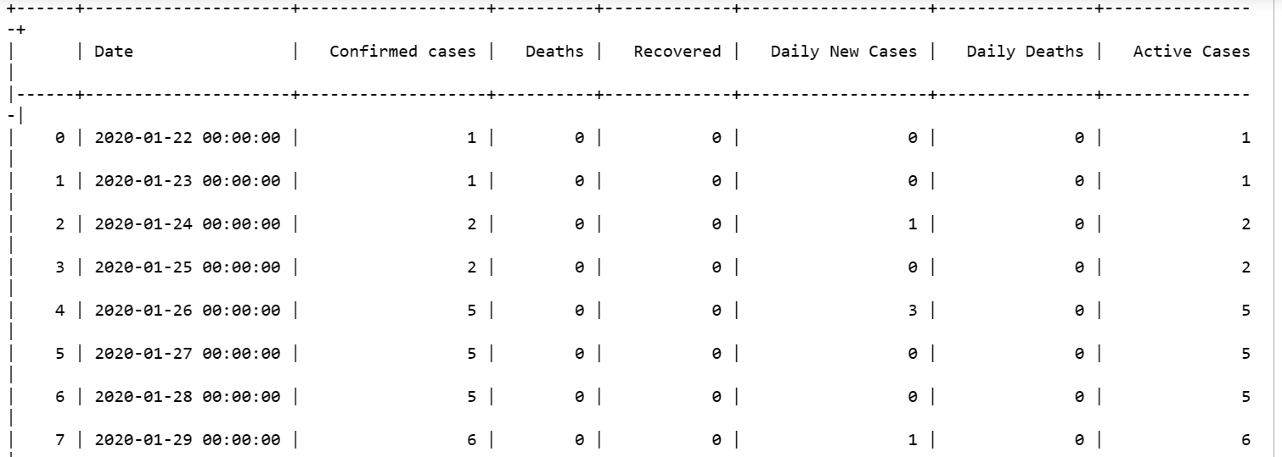
Covid 19 dataset

Slide 7
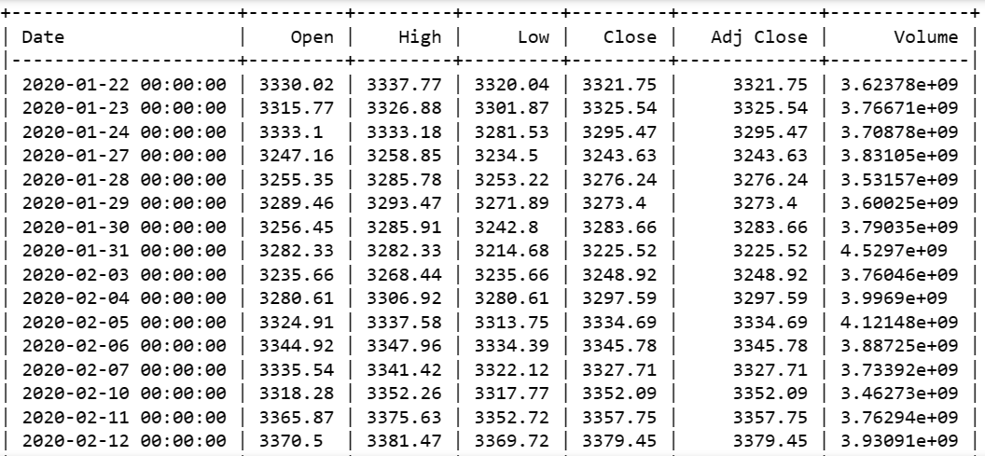
S&P500 Dataset

Slide 8
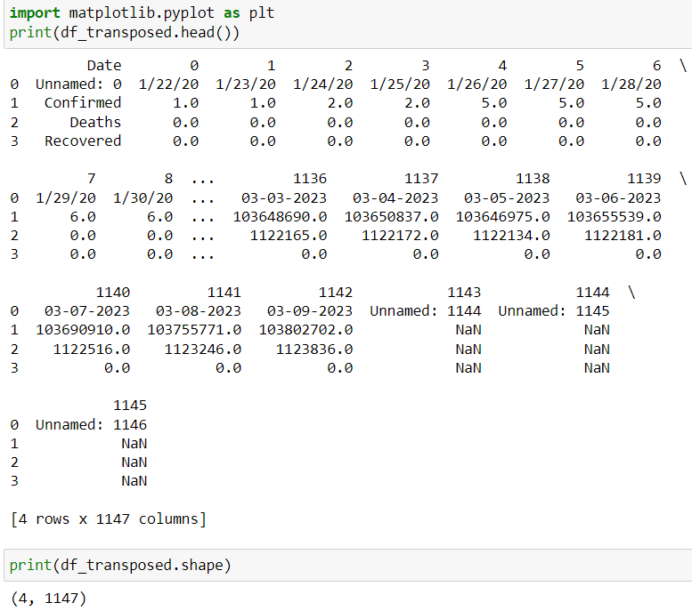
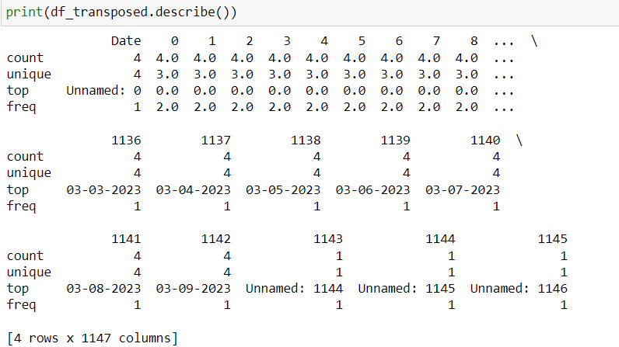
Exploratory Data Analysis
Performed Exploratory data analysis on the collected datasets.

Slide 9
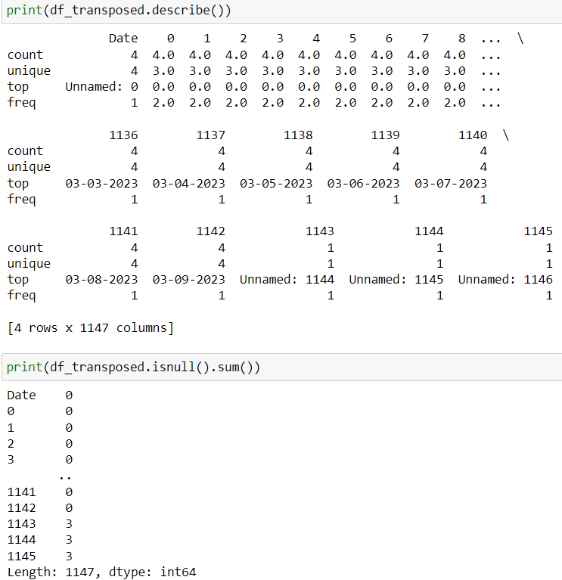
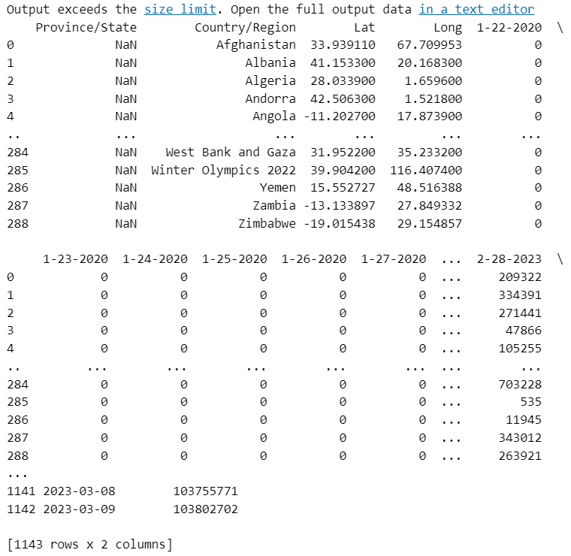
EDA for covid dataset (CONT)

Slide 10
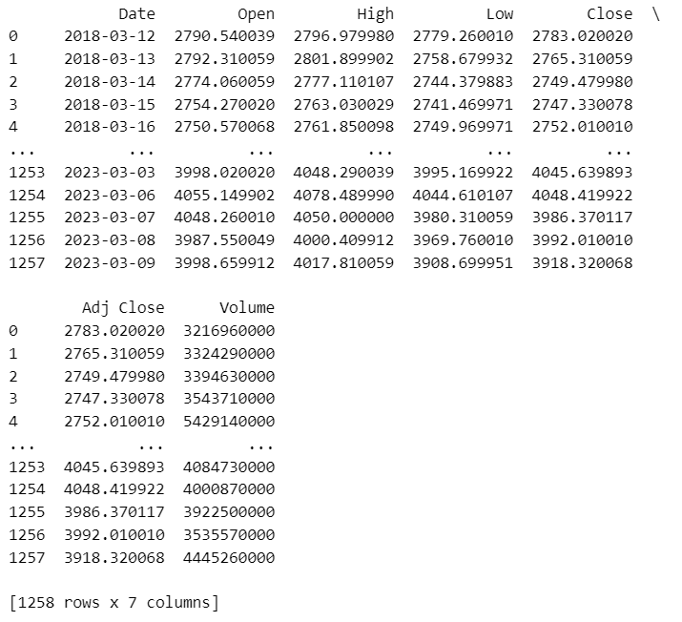
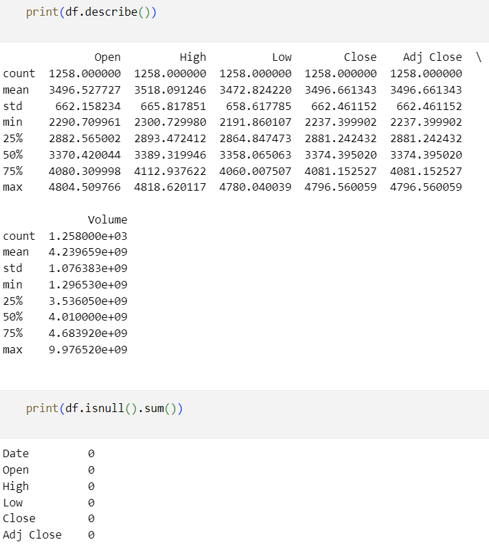
EDA for Sp500 dataset (CONT)

Slide 11
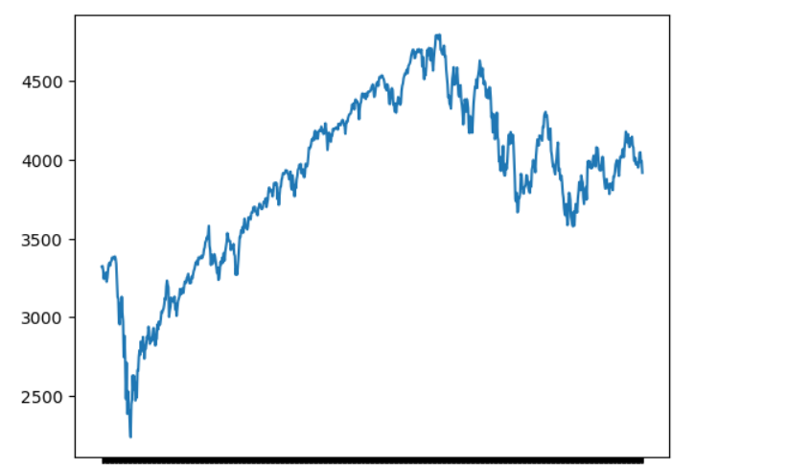
EDA for Sp500 dataset (CONT)

Slide 12
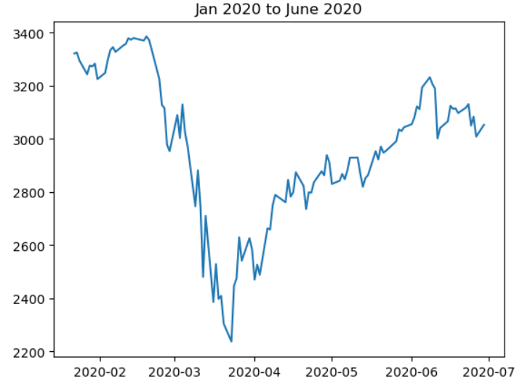
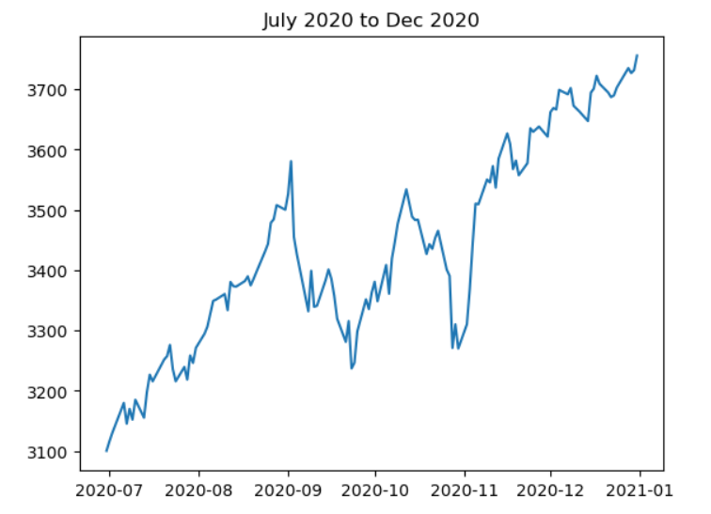
EDA for Sp500 dataset (CONT)
SP500 index V/S date in a time frame of six months from start of covid to till date

Slide 13
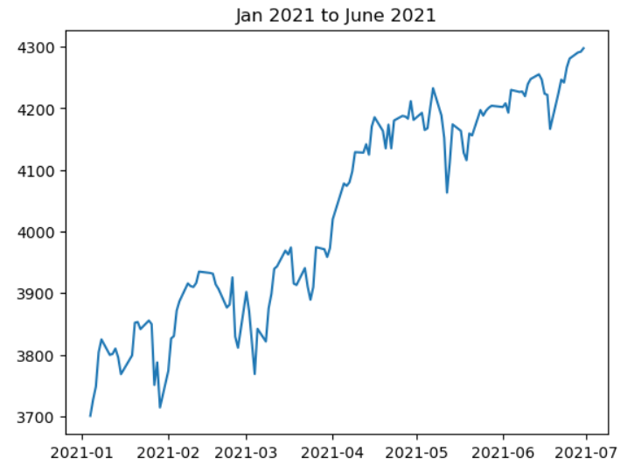
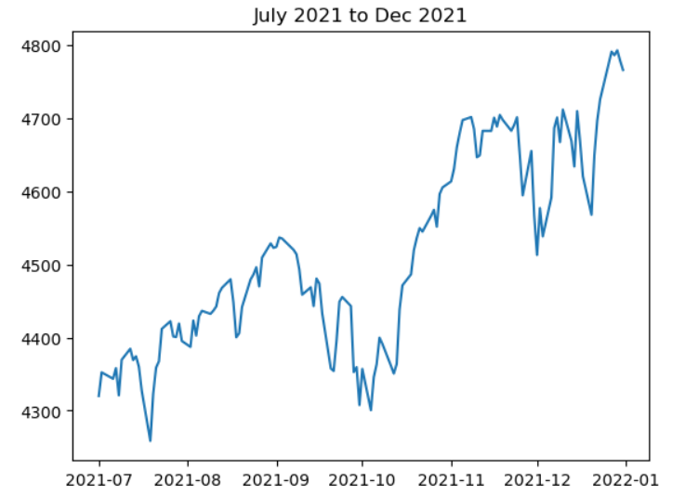
EDA for Sp500 dataset (CONT)
SP500 index V/S date in a time frame of six months from start of covid to till date

Slide 14
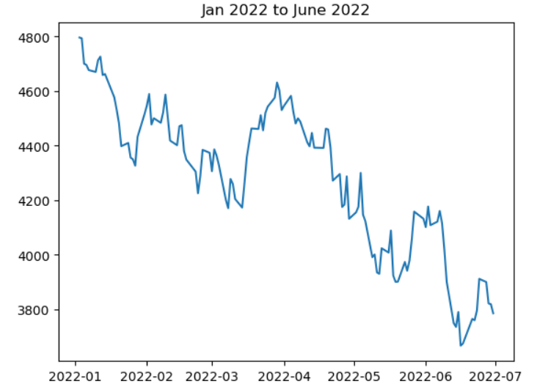
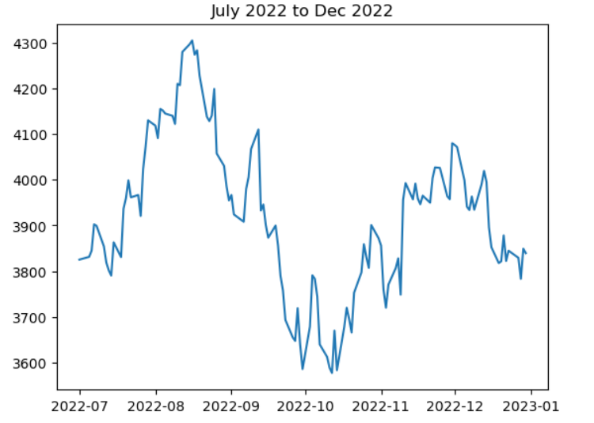
EDA for Sp500 dataset (CONT)
SP500 index V/S date in a time frame of six months from start of covid to till date

Slide 15
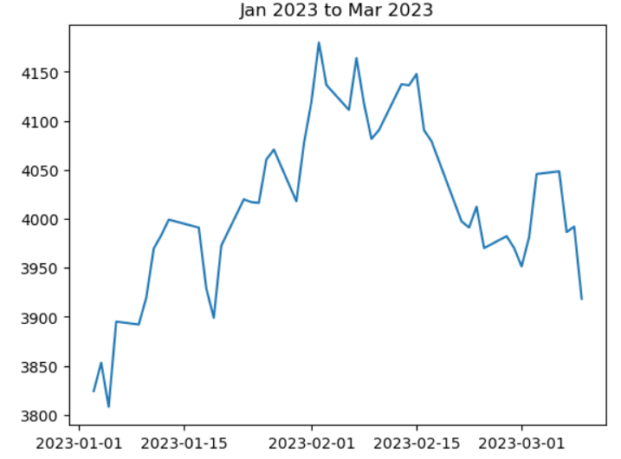
EDA for Sp500 dataset (CONT)
SP500 index V/S date in a time frame of six months from start of covid to till date

Slide 16
Data preprocessing is the foundation of every successful data science project. Just like a sculptor needs to shape and refine their raw materials to create a masterpiece, a data scientist must preprocess and cleanse data to extract meaningful insights and build accurate models.
“
”

Slide 17
Data Preprocessing
Merging S&P dataset and Covid-19 dataset together
Date format
Handling missing values
Select appropriate columns which are needed to analyze the stock exchange variation with Covid
Remove the correlated columns
Remove the unnecessary columns

Slide 18
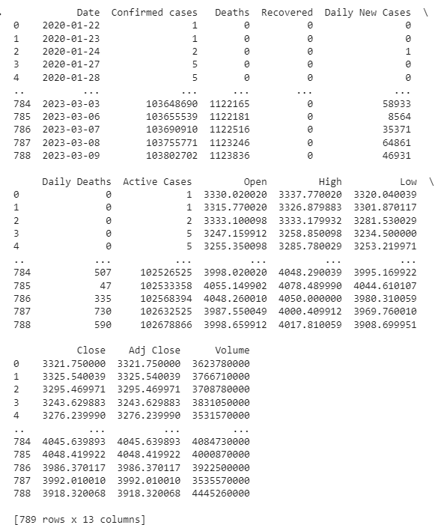
Data Preprocessing
The following is the merged dataset of Covid19 and SP500 dataset.
Changed the date format as per our requirement.
Handling missing values
Average of the previous and next rows of the missing value columns and put it on the missing value row

Slide 19
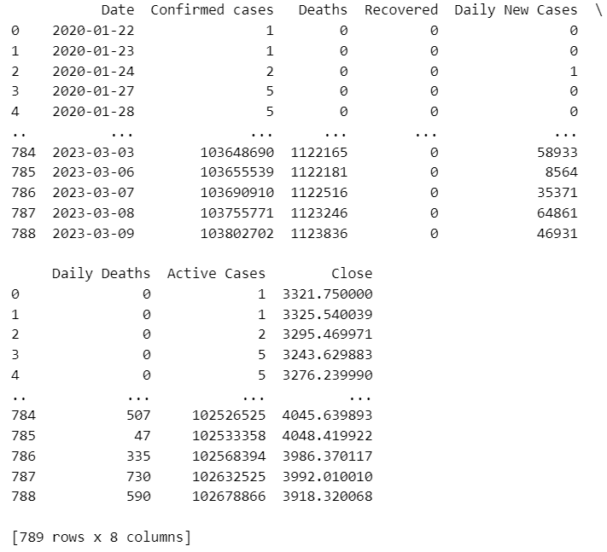
Data Preprocessing
Select appropriate columns which are needed to analyze the stock exchange variation with Covid
Remove the correlated columns
Remove the unnecessary columns

Slide 20
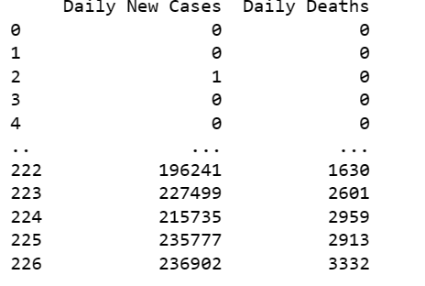
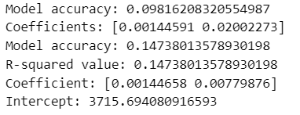
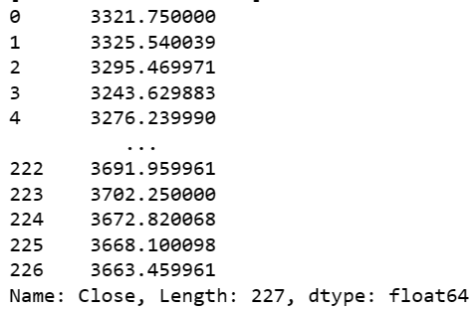
Data Modelling
We performed linear regression on preprocessed data to gather insights like how covid impacted SP500
Input:
Prediction Variable:

Slide 21
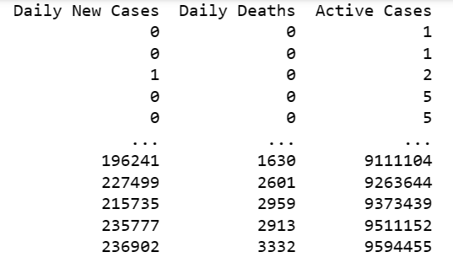

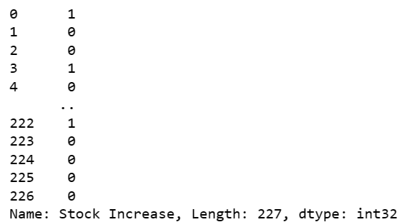
Data Modelling
We performed logistic regression on preprocessed data to gather insights.
Input:
Prediction Variable:

Slide 22
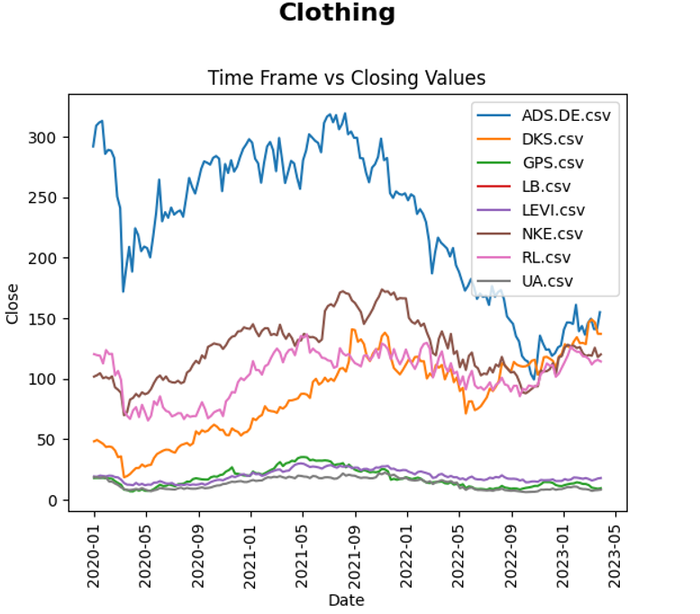
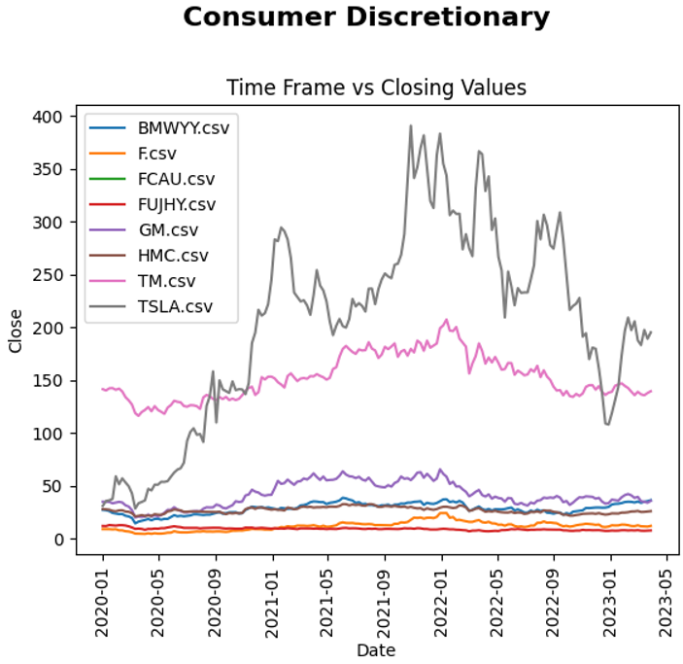
Data Visualization
Impact of COVID on individual companies in the S&P 500 based on the sector:

Slide 23
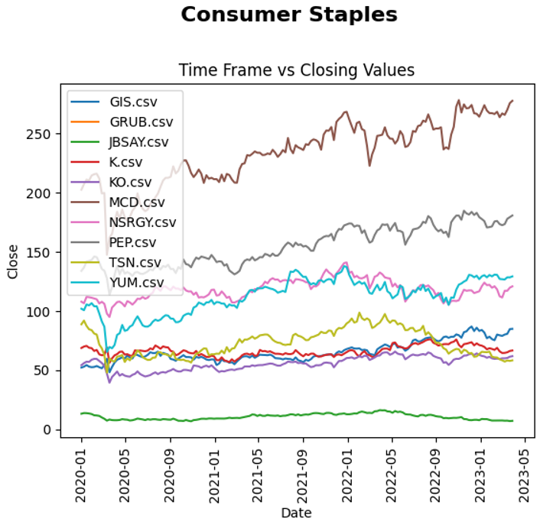
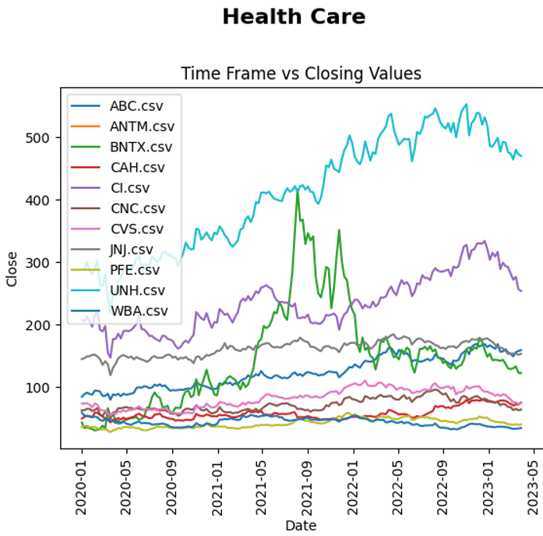
Data Visualization
Impact of COVID on individual companies in the S&P 500 based on the sector:

Slide 24
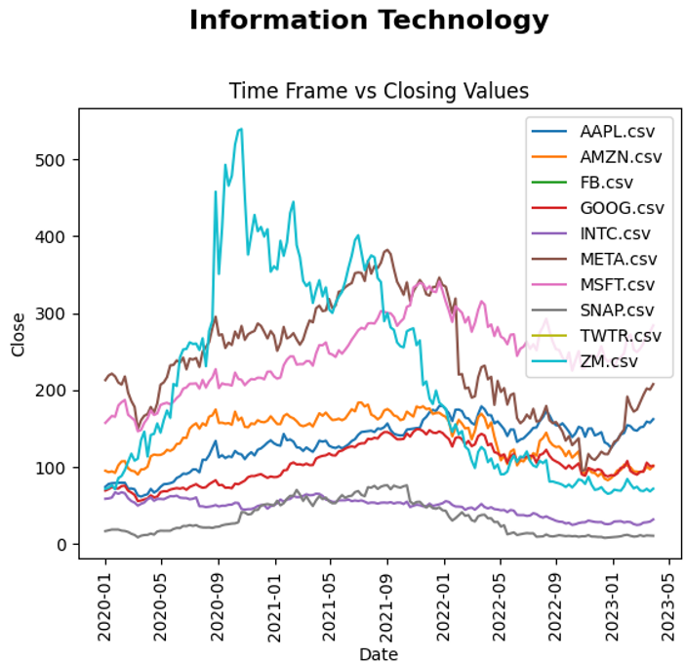
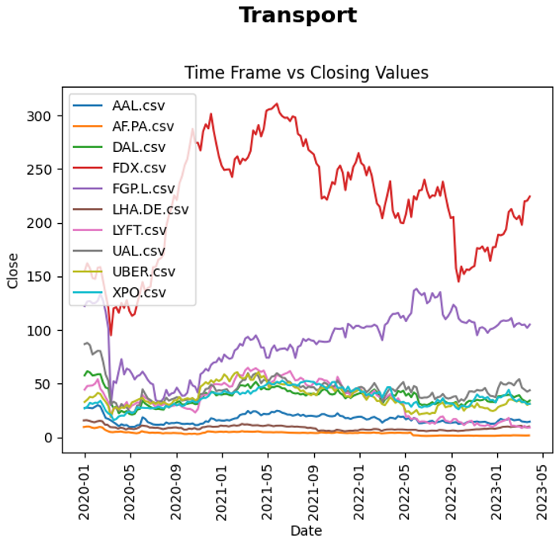
Data Visualization
Impact of COVID on individual companies in the S&P 500 based on the sector:

Slide 25
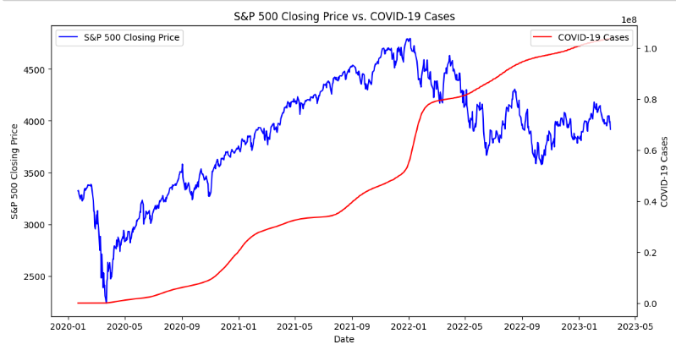
Data Visualization
Impact of the S&P 500 on COVID:

Slide 26
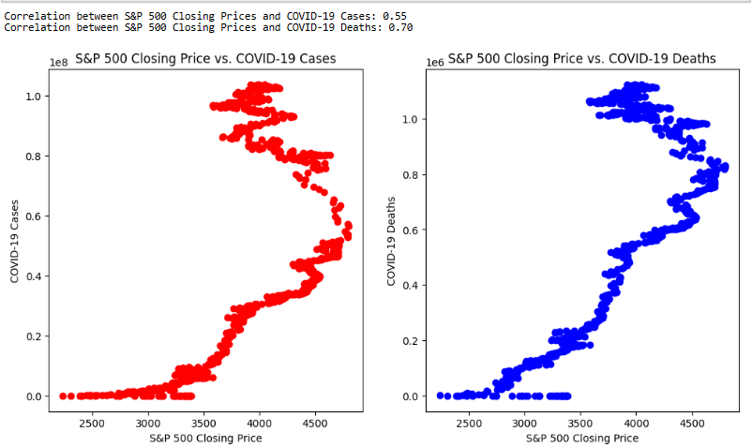
Data Visualization
Impact of the S&P 500 on COVID:

Slide 27
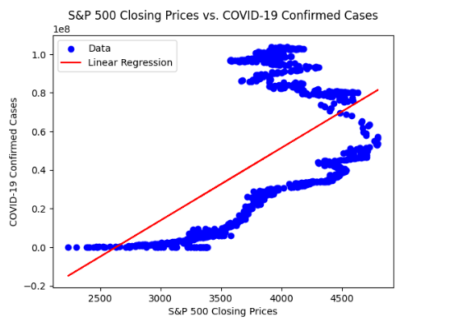

Data Visualization
Model visualization:

Slide 28
SUMMARY
Utilized various data science techniques such as data gathering, visualization, and analysis.
The accuracy of your model's predictions was around 0.5, indicating room for improvement.
Observed that COVID-19 had a significant impact on the S&P 500 in the initial phases, but the impact reduced in later phases.
Attempted to analyze the reverse relationship of S&P 500's impact on COVID-19 cases.
However, the prediction error rate was high, indicating challenges in accurately predicting the relationship between the two variables.

Slide 29
FUTURE Work
Analyzing the impact of government regulations on the stock market
Exploring the global impact of the US stock market on other countries' stock markets
Exploring the global impact of the US stock market on other countries' stock markets
Incorporating external factors
Exploring alternative modeling approaches

Slide 30
THANK YOU

